Slide 1

Home Sale Prices Analysis
Hayley Baek
Notes:
Today I’m going to be looking at a factor that drive sale prices for homes by suggesting a hypothesis and quantitatively analyzing the data to make a business recommendation.

Slide 2
Bathroom Factor on Sale Price
Each house has between 1-6 total bathrooms
Number of bathrooms
Two types: full and half
Two locations: above ground and basement
Bathrooms are a necessity
Willingness to pay for more bathrooms
Notes:
Specifically, I’m going to see what a difference in sale price looks like for houses with different number of bathrooms.
[x] From my analysis, I found that any given home will have anywhere between 1 and 6 total bathrooms.
[x] The data I looked at provided four different categories for bathrooms: full and half bathrooms and also above ground and basement bathrooms.
[x] I’m looking at the number of total bathrooms affecting sale prices on the principle that bathrooms are a necessity for homes and that
[x] there is a willingness to pay more money for a home with more bathrooms. [END SLIDE]

Slide 3
Data
Bathroom and sale price data extracted from sale history
Total Bathrooms = Basement full bathroom + Basement half bathroom + Above ground full bathroom + Above ground half bathroom
Each house has between 1 and 6 total bathrooms
Notes:
To give a little bit of a background on the data,
[x] I’ve extracted my insights from a history of past sales, and included with those sales are various specifications about those homes.
[x] For the purposes of this analysis I’ve aggregated the four different categories of bathrooms into one bathroom count. Each house has a count for each of the four categories, and adding each of these counts into a total bathroom count is the number that I’ve been working with for my analysis.
[x] So while each home will have a different combination of the types of included bathrooms, I found that any given home will only have between 1 and 6 total bathrooms. [END SLIDE]

Slide 4
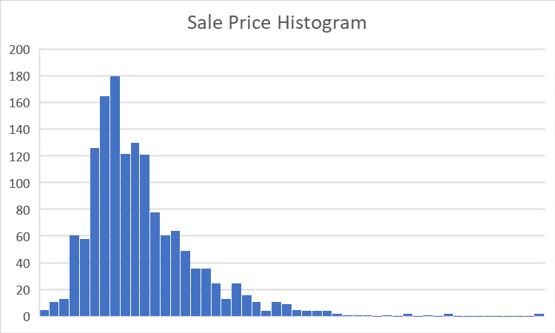
Normal Distribution Across Groups
Sale Price for all sales is a skewed normal distribution
Notes:
I want to go over how the sale price data is distributed across the categories for different bathroom counts and also what it looks like for all of the sales. Here, you can see that the sale prices for the entire sales history data is normally distributed with a slight skew so that most of the data falls in the range of about $100k to $200k. [END SLIDE]

Slide 5
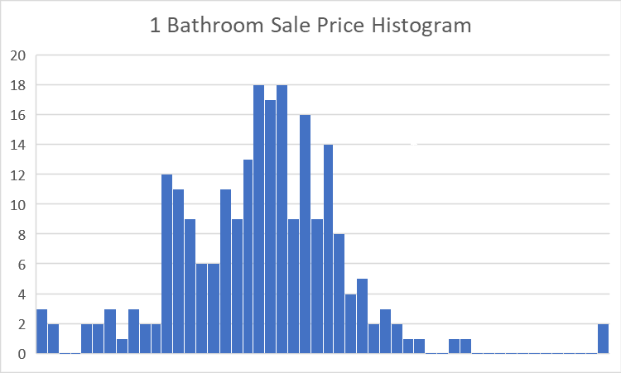
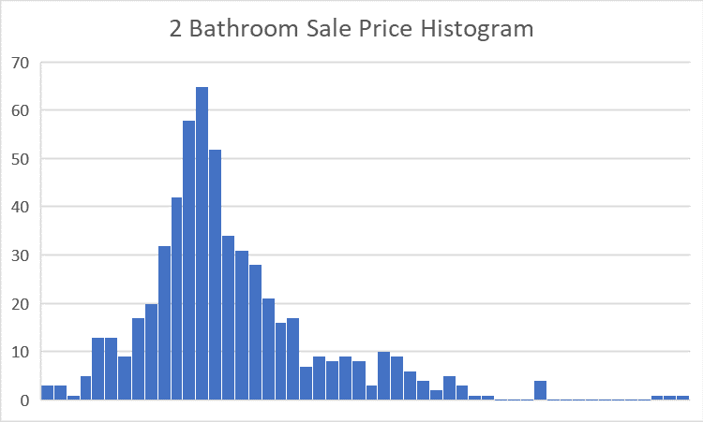
Normal Distribution Across Groups
Houses with only 1 bathroom or only 2 bathrooms follow a skewed normal distribution
Notes:
The distribution for homes with only 1 bathroom roughly follows a normal distribution with the mode around $100k-130k. The distribution for homes with 2 bathrooms also follows a normal distribution with most the homes priced around $120k-150k. [END SLIDE]

Slide 6
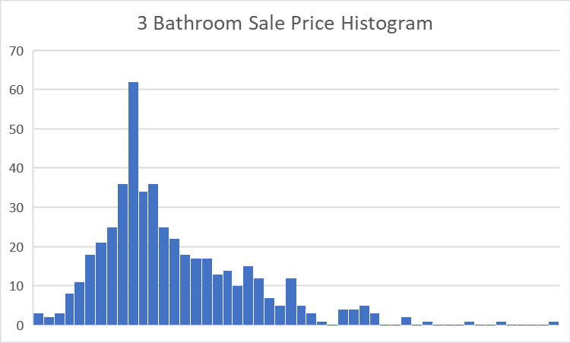
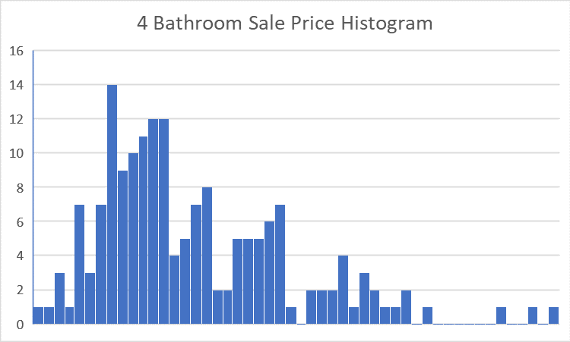
Normal Distribution Across Groups
Houses with 3 bathrooms or 4 bathrooms follow a skewed normal distribution
Notes:
The distribution for homes with 3 total bathrooms follows a normal distribution with the mode around $150k-200k. The distribution for homes with 4 bathrooms also roughly follows a normal distribution with most the homes priced around $160k-220k. [END SLIDE]

Slide 7
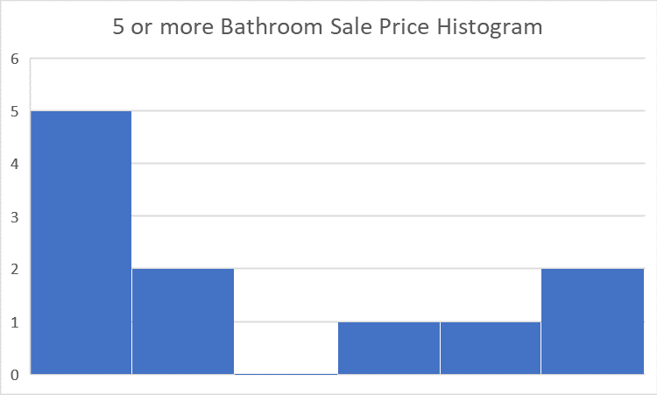
Normal Distribution Across Groups
Houses with 5+ bathrooms comparatively very small sample size
Group does not seem to approximate towards a normal distribution
Notes:
The same cannot be said for homes with 5 or more total bathrooms. This group of homes doesn’t seem to follow a normal distribution of sale prices. When trying to plot the distribution for 5 and more bathrooms, I found that there simply wasn’t enough data in the sales history to have a fair analytical test, so just keep that in mind moving forward. [END SLIDE]

Slide 8
Hypothesis
Does the number of bathrooms significantly affect the sale price?
Ho: # of bathrooms does not significantly affect sale price
Ha: # of bathrooms does significantly affect sale price
Notes:
The hypothesis I want to put forth to investors is
[x] to see if the number of bathrooms significantly affects the sale price. The null hypothesis I’m looking to reject is to see
[x] if the total number of bathrooms does not significantly affect the sale price, and rejecting this will prove that
[x] there is in fact empirical evidence to prove that the total number of bathrooms does significantly affect the sale price. [END SLIDE]

Slide 9
Testing the Hypothesis
Hypothesis will be tested between different numbers of bathrooms and their sale prices for statistically significant differences
1 bathroom vs 2 bathrooms
2 bathrooms vs 3 bathrooms
3 bathrooms vs 4 bathrooms
4 bathrooms vs 5 or more bathrooms
Conduct 4 separate t-tests
Notes:
To test my hypothesis,
[x] I’m going to be comparing the consecutively different number of home bathrooms and testing for statistically significant differences between them.
[x] I’m going to test between 1 and 2 total bathrooms
[x] 2 and 3 total bathrooms
[x] 3 and 4 total bathrooms
[x] and 4 and 5 or more total bathrooms.
[x] In doing so, I’m going to be conducting 4 separate t-tests. [END SLIDE]

Slide 10
T-tests
Goal is to reject the null hypothesis
Ho = there is no significant difference in sale prices
Ha = there is a significant difference in sale prices
Prove that there is a significant difference in sale prices
If P value < 0.05, then reject null hypothesis
95% confidence interval
Notes:
In using the t-tests,
[x] my goal is to reject the null hypothesis, the hypothesis that suggests that there is no significant difference between total number of bathrooms and sale prices.
[x] In doing so, then the conclusive evidence from the data will suggest that there is a significant difference in sale prices.
[x] When conducting these tests, I will get a derived p value which indicates a rejection or failure of rejection of the null hypothesis.
[x] I’m conducting these analyses a 95% confidence interval, meaning that I’m looking for a p value that is less than 0.05 for a null hypothesis rejection. [END SLIDE]

Slide 11
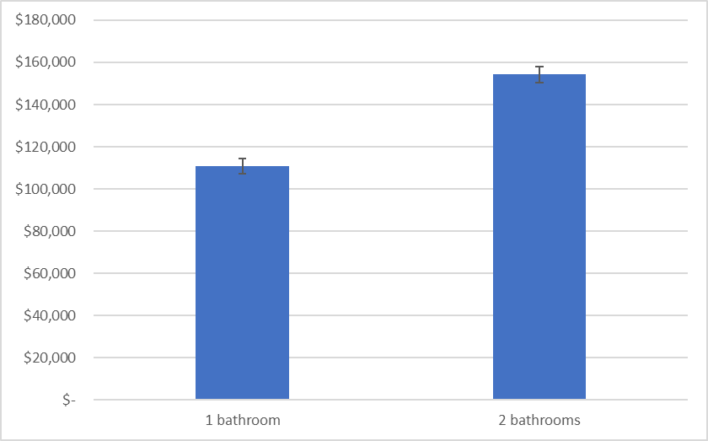
1 Bathroom vs 2 Bathrooms
Reject Ho at p = 6 x 10^-49
There is a significant difference in sale price between 1 and 2 bathrooms
Confidence intervals
1 bath: +/- 3689.84
2 bath: +/- 3856.25
Notes:
My first t-test is comparing sale prices between homes with 1 vs 2 total bathrooms.
[x] I was able to reject the hypothesis at this level with a p value very close to 0.
[x] This means that there is in fact a statistically significant difference in sale prices.
[x] In addition, the confidence intervals for these average means don’t overlap with each other as well, so I can say with 95% confidence that there is a difference in sale prices between 1 and 2 bathrooms. [END SLIDE]

Slide 12

2 Bathrooms vs 3 Bathrooms
Reject Ho at p = 6 x 10^-50
There is a significant difference in sale price between 2 and 3 bathrooms
Confidence intervals
2 bath: +/- 3854.95
3 bath: +/- 6017.20
Notes:
My next t-test is comparing sale prices between homes with 2 vs 3 total bathrooms.
[x] I was able to reject the hypothesis at this level as well with a p value very close to 0.
[x] This means that there is in fact a statistically significant difference in sale prices.
[x] In addition, the confidence intervals for these average means also don’t overlap with each other, so I can say with 95% confidence that there is a difference in sale prices between 2 and 3 bathrooms. So far I’ve shown that there is a significant difference in home sale prices between 1 and 2 and 3 total bathrooms [END SLIDE]

Slide 13
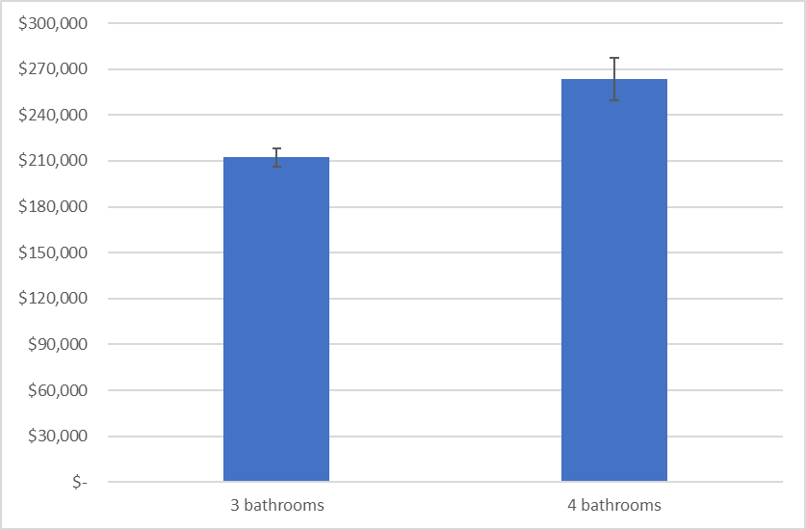
3 Bathroom vs 4 Bathrooms
Reject Ho at p = 1 x 10^-10
There is a significant difference in sale price between 3 and 4 bathrooms
Confidence intervals
3 bath: +/- 6039.13
4 bath: +/- 13,944.79
Notes:
Continuing in this fashion my next t-test is comparing sale prices between homes with 3 vs 4 total bathrooms.
[x] I was again able to reject the hypothesis at this level with a p value very close to 0.
[x] This means that there is in fact a statistically significant difference in sale prices.
[x] As with the previous two tests, the confidence intervals for these average means also don’t overlap with each other, so I can say with 95% confidence that there is a difference in sale prices between 3 and 4 bathrooms. Having shown that there is a significant difference in home sale prices between 1 and 4 total bathrooms, the last t-test is to see if there is a significant sale price difference between 4 and 5 or more bathroom homes [END SLIDE]

Slide 14
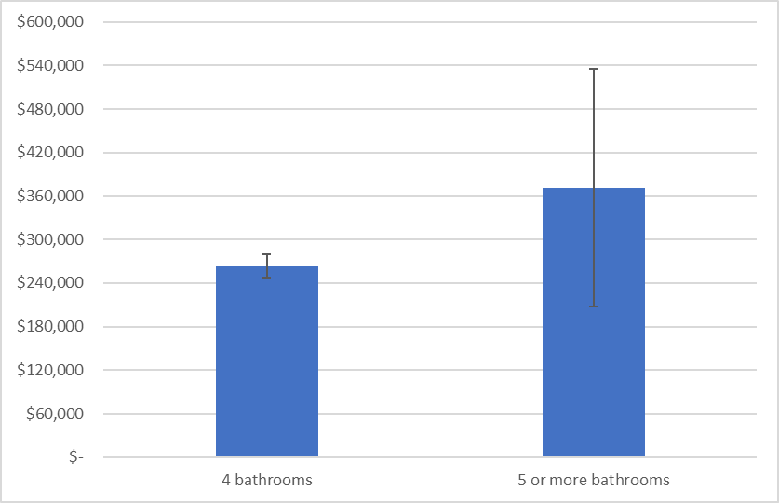
4 Bathrooms vs 5+ Bathrooms
Fail to reject Ho at p = 0.17 (>0.05)
There is no significant difference in sale price between 4 and 5+ bathrooms
Confidence intervals
4 bath: +/- 15,772.19
5 or more bath: +/- 163,931.39
Notes:
My final t-test is comparing sale prices between homes with 4 vs 5 or more total bathrooms.
[x] Unfortunately, I was unable to reject the hypothesis at this level with a p value exceeding 0.05.
[x] This means that the given data cannot be worked with tell for sure if there is a significant difference in sale prices between 4 total bathrooms and 5 or more total bathrooms.
[x] The confidence intervals for these average means clearly overlap with each other, and the large error bars in the data with 5 or more total bathroom could be explained by our sample size being so small and not following a normal distribution. [END SLIDE]

Slide 15
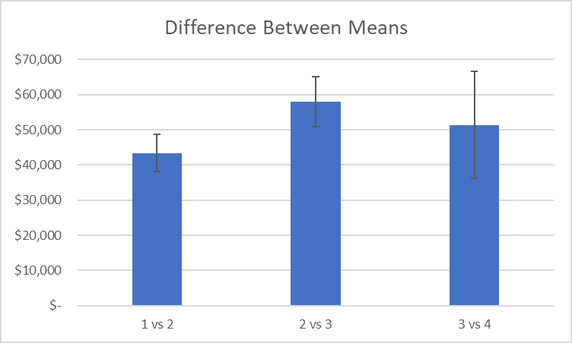
Takeaway
Rejected null hypothesis for t-tests for 1-4 total bathrooms affecting sales prices
# of bathrooms statistically significant differences in sales prices for houses having 1-4 bathrooms
Should invest in houses with more bathrooms for larger returns on sale prices
Notes:
To conclude my presentation, I’ve included a graph indicating the difference between means in the tests
[x] where I’ve been able to reject the null hypothesis for testing homes between 1-4 total bathrooms affecting sale prices
[x] and I can conclude that there is a statistically significant difference in sale price for homes that have between 1 and 4 houses. As you can see, there is an overall positive difference between these average home sale prices, indicating that more bathrooms means larger sale prices.
[x] My recommendation to investors is to invest in homes that have more than 1 or 2 total bathrooms. Since there is risk in investing in homes with 5 or more total bathrooms since there isn’t enough data in past sales, I don’t recommend investing in homes with any more than 4 bathrooms, and the correlation between homes with 5 or more bathrooms and their volume of sales should be looked into further.

